Slide 1

Spring Security
1

Slide 2
Table of Contents
Basic Authentication
Authority Based Basic Authentication
JWT
Headers
Custom Security Filter
Security Exception Handling
CSRF , CORS
2

Slide 3
Headers
The HTTP headers are used to pass additional information between the clients and the server through the request and response header.
Examples
Autherization, Authentication, Content-Type, Accept, X-Csrf-Token
3

Slide 4
Custom Security Filters
addFilterAfter(filter, class)–Adds a filter after the position of the specified filter class.
addFilterBefore(filter, class)–Filter before the position of the specified filter class.
addFilterAt(filter, class)–Adds a filter at the location of the specified filter class.
addFilter(filter)–adds a filter that must be an instance of or extend the filter provided by Spring Security
3

Slide 5
Security Exception Handling
Spring Securit can handle exception with respect to our purpose.
Such as
BearerTokenAuthenticationEntryPoint, BearerTokenAccessDeniedHandler
4

Slide 6
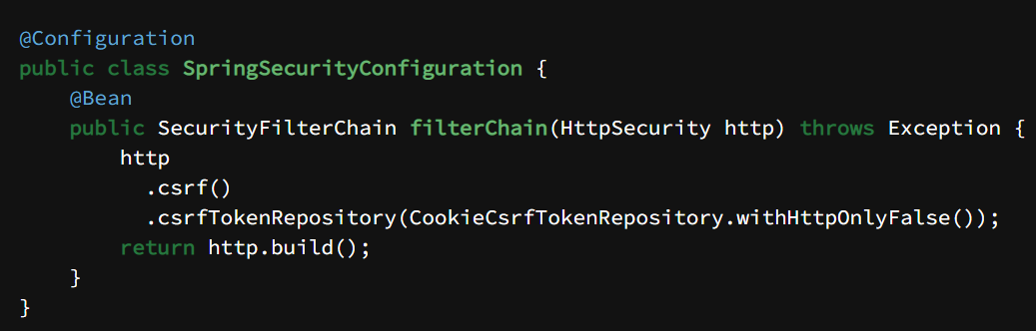
CSRF
Definition. Cross-Site Request Forgery (CSRF) is an attack that forces authenticated users to submit a request to a Web application against which they are currently authenticated. CSRF attacks exploit the trust a Web application has in an authenticated user.
4

Slide 7
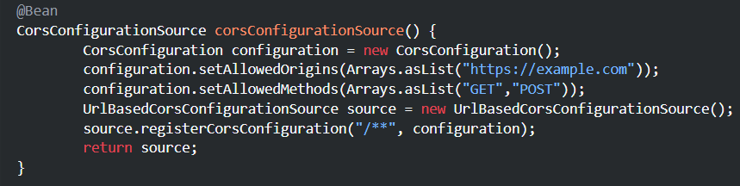
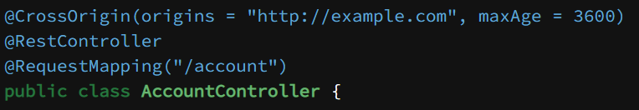
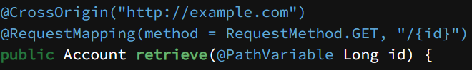
CORS
Cross-Origin Resource Sharing (CORS) is an HTTP-header based mechanism that allows a server to indicate any origins (domain, scheme, or port) other than its own from which a browser should permit loading resources.
4

Slide 8
TEŞEKKÜRLER
24

